Slide 1
USECASE AND CLASS DIAGRAM OF ENEMIES

Slide 2
AJ (Enemies 0veRVIEW)
TL5
Show up & start: Enemies appear and begin walking a set route (patrol = loop between fixed points while watching for the player).
Look for you: They keep checking with sight/hearing (perception & line-of-sight) to find the player.
Change mode: If they spot you → Patrol → Chase → Attack → (Flee or Die).
Chase smartly: They run toward you using paths; if they lose you for a few seconds, they return to patrol.
Fair attacks: Clear wind-up and short hit window; send damage to Combat and update the HUD.
When hit: They can stagger; at 0 HP they play death, drop loot, and we mark them defeated (save flag).
Gets harder: Scaling makes enemies tougher later (more HP / speed / aggression).
Remember progress: The game saves defeated enemies and loot rolls.
Run smoothly: Throttle checks, ignore far enemies, and use simpler off-screen behavior for performance.
Priority: High — drives challenge/tension and connects Level, Combat, UI, Scaling, Save. Complexity: Medium–High — live AI state machine, pathfinding + perception, lots of enemies, multi-system integration, plus save/load.

Slide 3
Aj (Usecase scenario 1)
TL5
Name: Detect & Chase
Summary: Enemy notices the player and starts chasing until in attack range or the player is lost. Actors: Player, Enemy System Preconditions: Enemy is active and patrolling; game running. Basic sequence:
Enemy patrols its route.
Perception check runs (vision/hearing/LOS). (<<include>> Evaluate Perception)
If the player is detected, switch state to Chase Player. (<<extend>> Detect Player)
Enemy moves toward player using pathfinding.
If within attack distance, hand off to Attack Player. Exceptions:
Step 3: Player breaks line-of-sight for N seconds → Handle Lost Sight and return to Patrol Area.
Step 4: Path blocked → choose alternate path; if none, return to Patrol Area. Post conditions: Enemy is either attacking or back on patrol. Priority: 1* ID: UC-EN-01

Slide 4
Aj (Usecase scenario 2)
TL5
Name: Attack Player
Summary: Enemy performs a readable attack when close enough to the player. Actors: Player, Enemy System Preconditions: Enemy is in Chase Player; player within attack range. Basic sequence:
Switch to Attack Player. (<<extend>> from Chase Player)
Telegraph the attack (wind-up).
Execute attack; hitbox active briefly.
If the hit connects, apply damage and show HUD feedback. (calls Combat)
Enter short recovery, then decide to repeat attack or return to Chase Player. Exceptions:
Step 3: Player dodges/blocks/parries → enemy stagger/recover and return to Chase Player.
Step 2–3: Player moves out of range mid wind-up → cancel and return to Chase Player. Post conditions: Attack finishes; enemy either chases again or resets. Priority: 1* ID: UC-EN-02

Slide 5
Aj (Usecase scenario 3)
TL5
Name: Die & Drop Loot
Summary: When HP reaches 0, the enemy dies, drops loot, and the defeat is saved. Actors: Player, Enemy System, Save System Preconditions: Enemy HP reduces to 0 (via Take Damage). Basic sequence:
Play death animation; disable AI/collisions.
Die & Drop Loot spawns item(s) using loot table. (notifies HUD/Inventory)
Save/Load Enemy State records enemy_defeated = true. (<<include>> Save/Load Enemy State)
Despawn the body after a short delay. Exceptions:
Step 2: Inventory full → keep item as ground pickup.
Step 3: Save fails → mark retry flag for next checkpoint. Post conditions: Enemy removed; loot available; defeat state saved (won’t respawn on reload). Priority: 2 ID: UC-EN-03

Slide 6


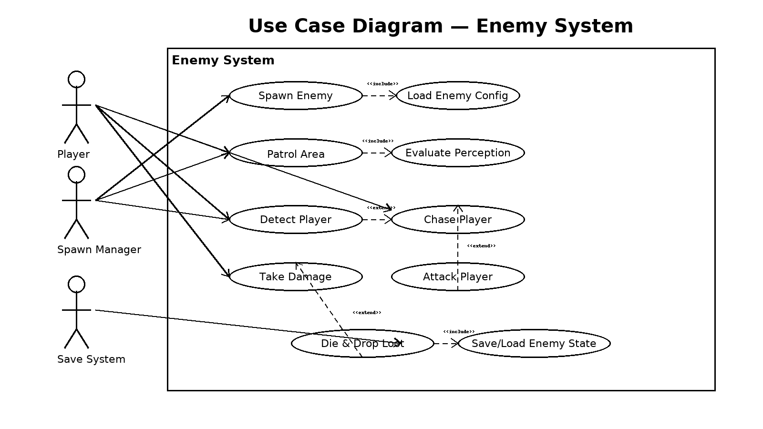
TL5
AJ ( USECASE DIAGRAM OF ENEMIES)

Slide 7
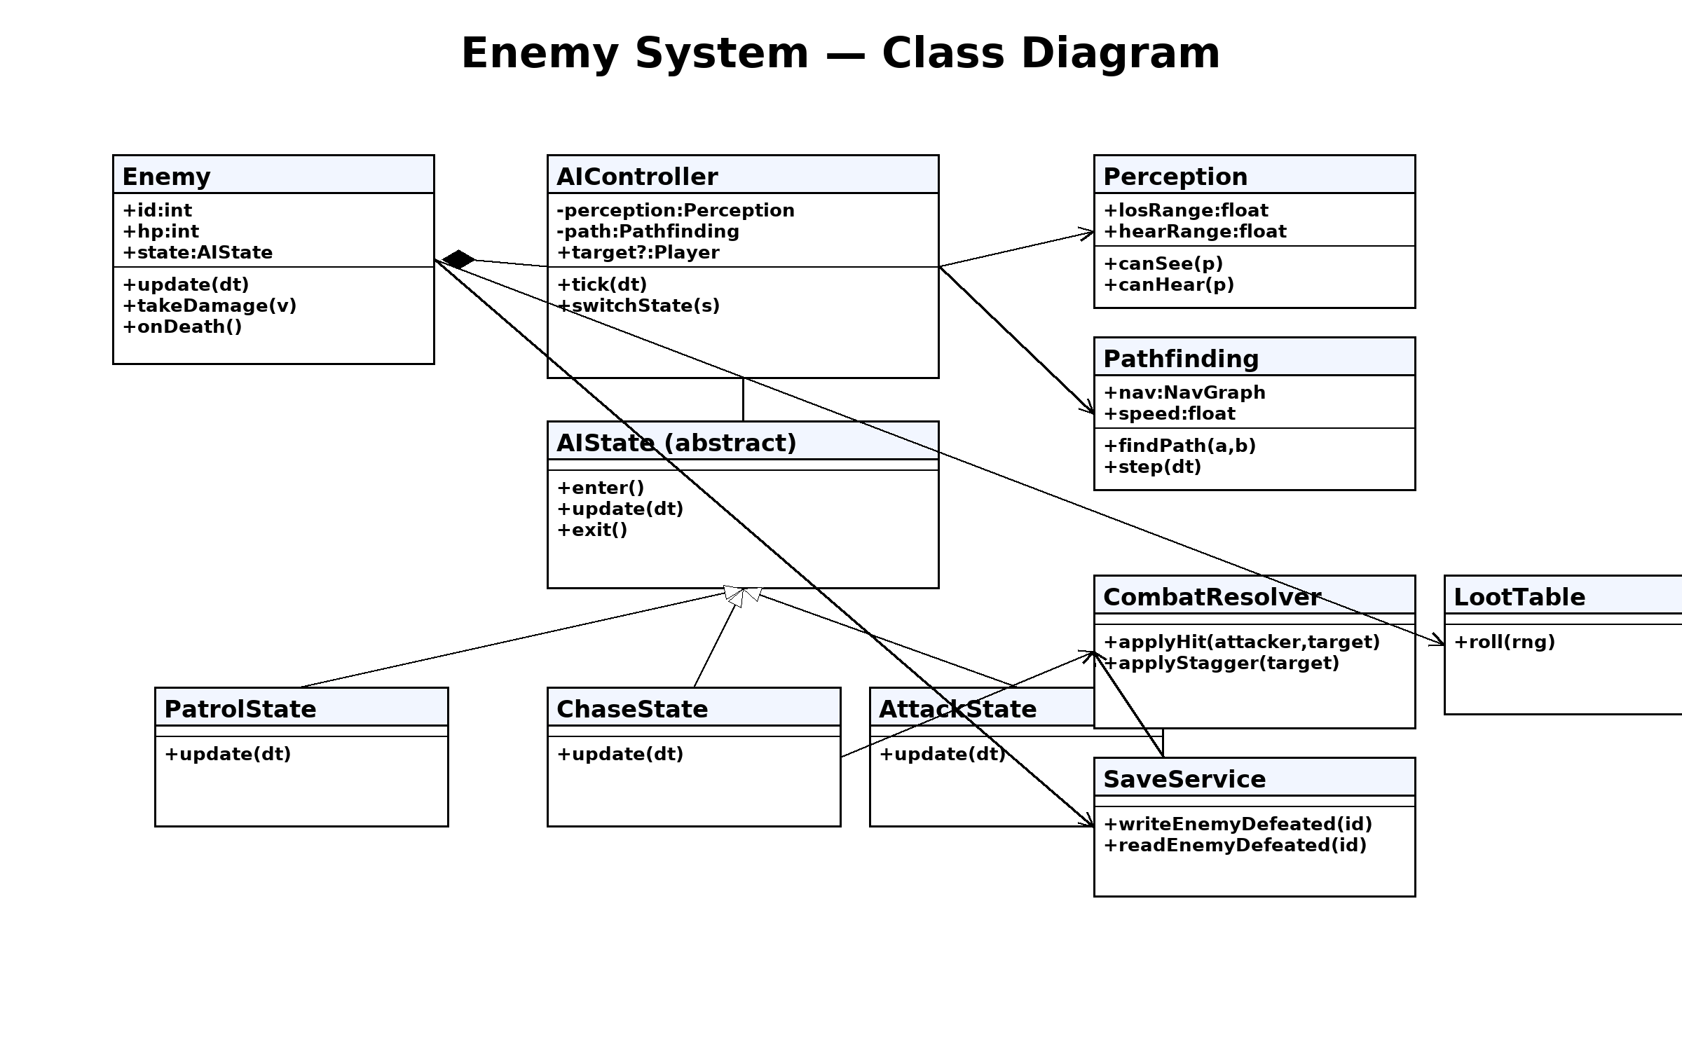
Aj (Class diagram)
TL5

